Slide 1
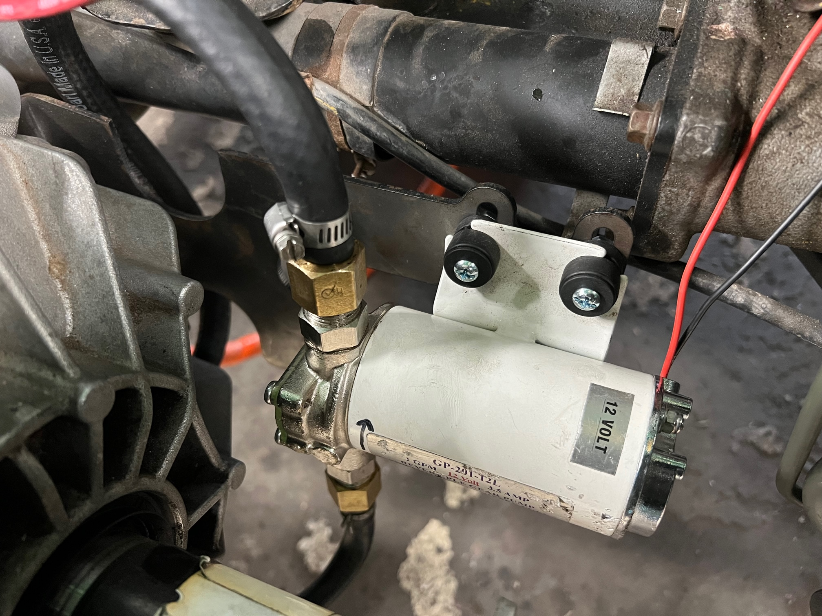
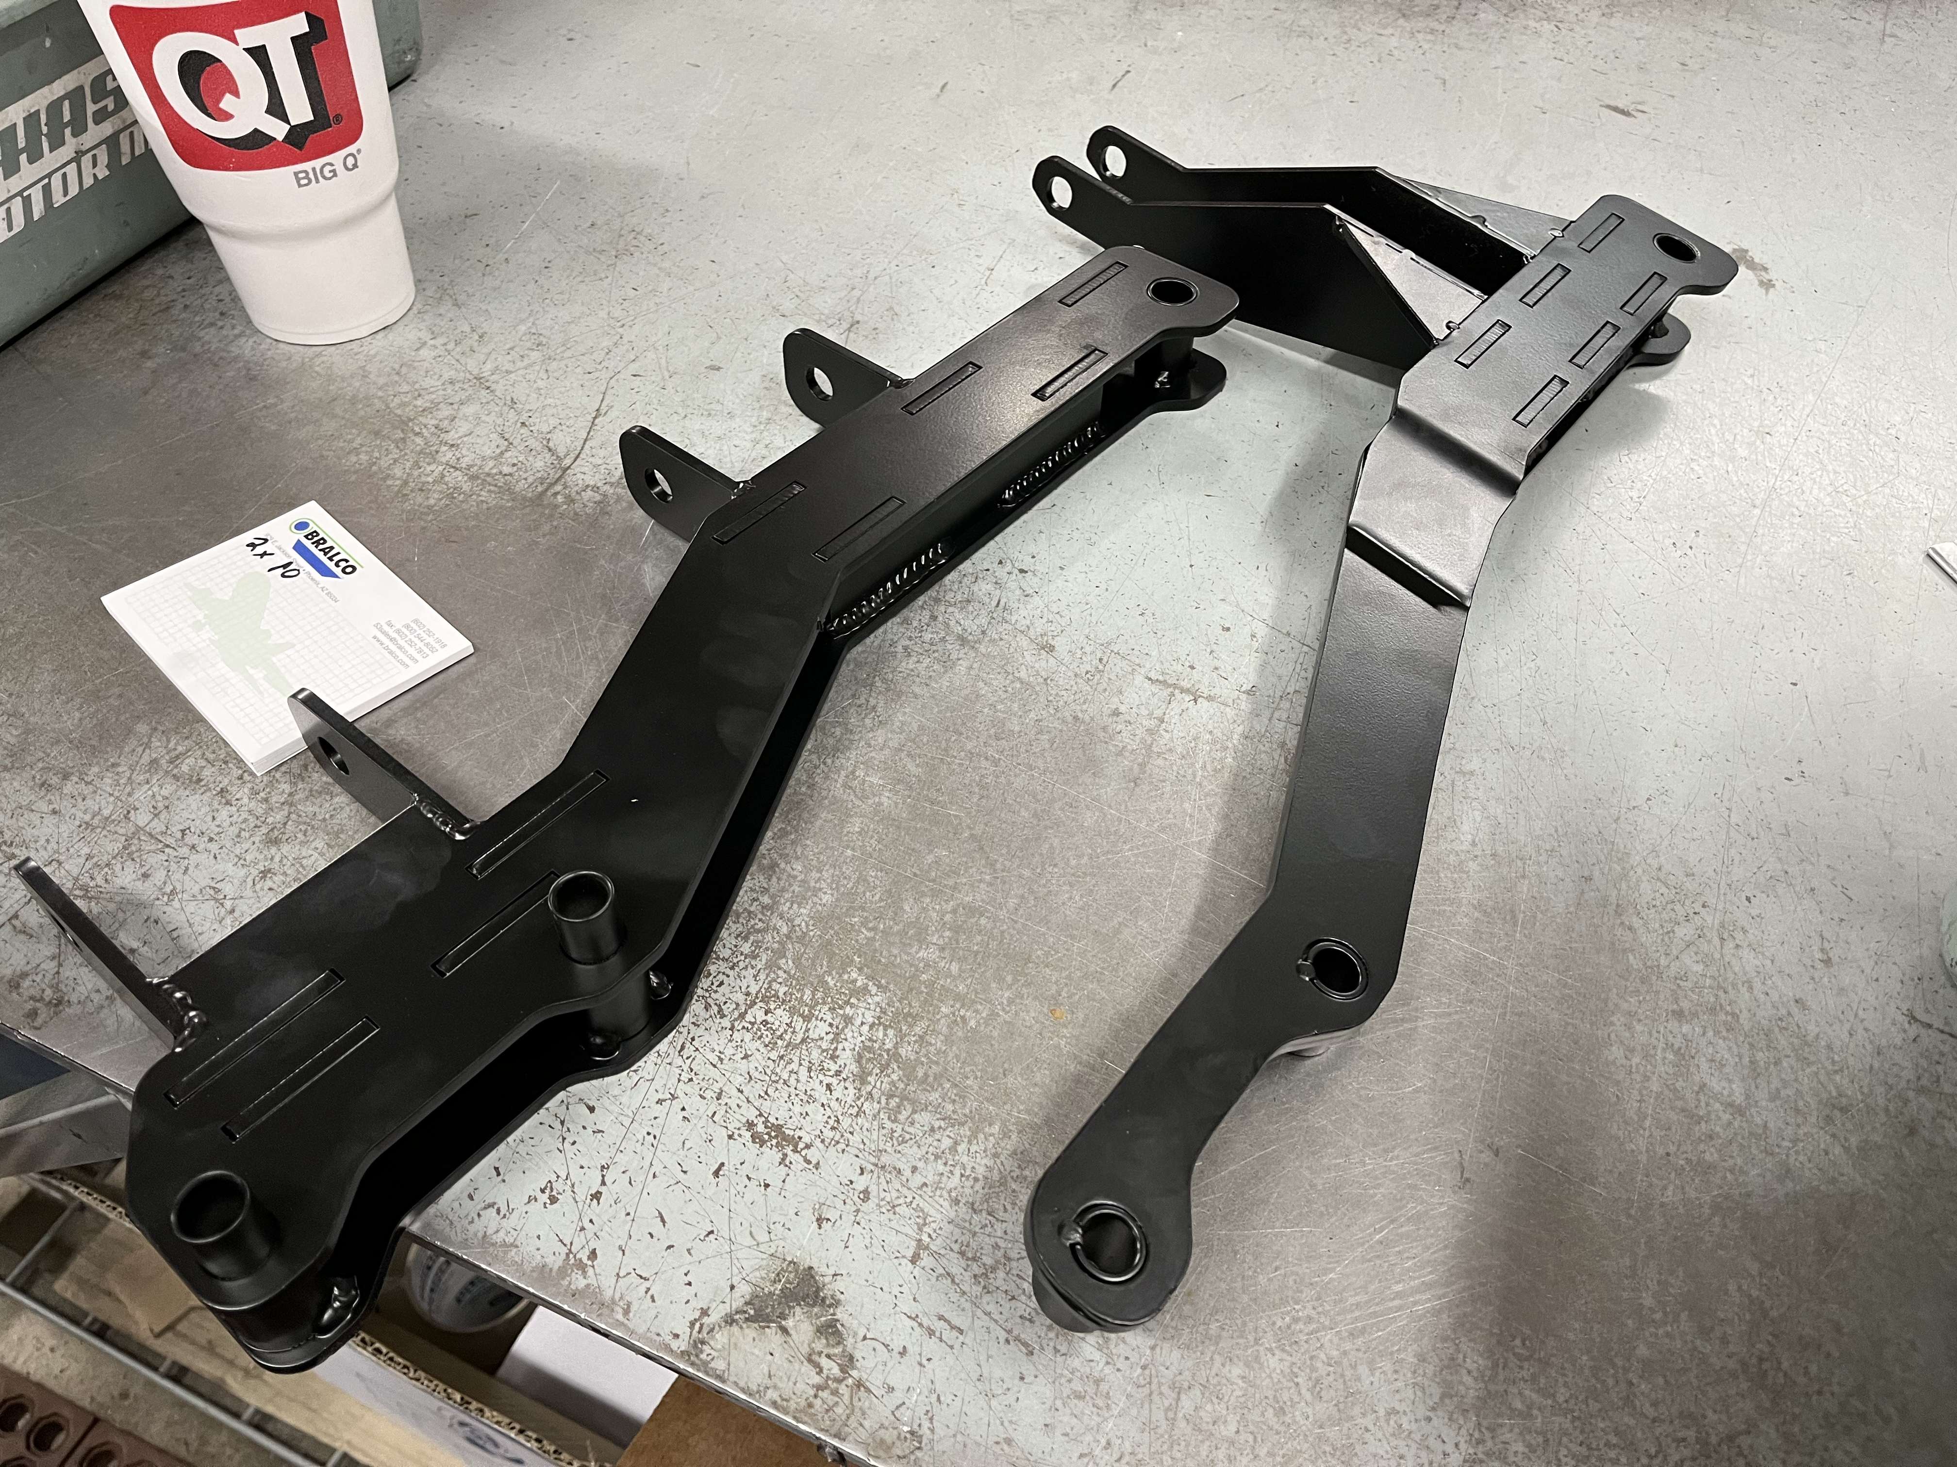
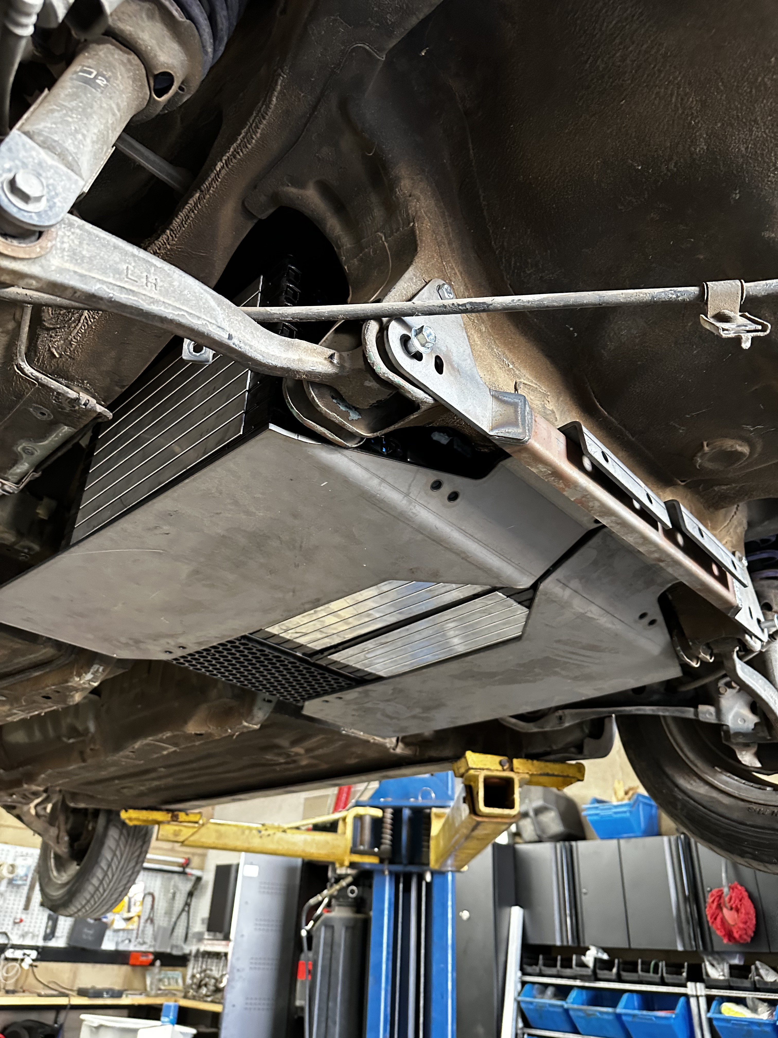
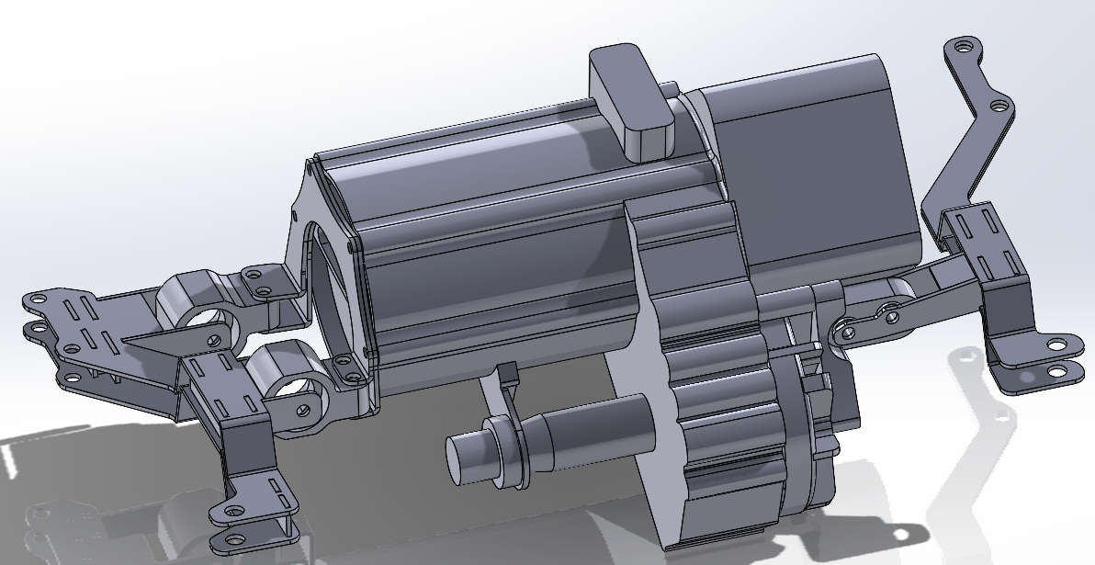
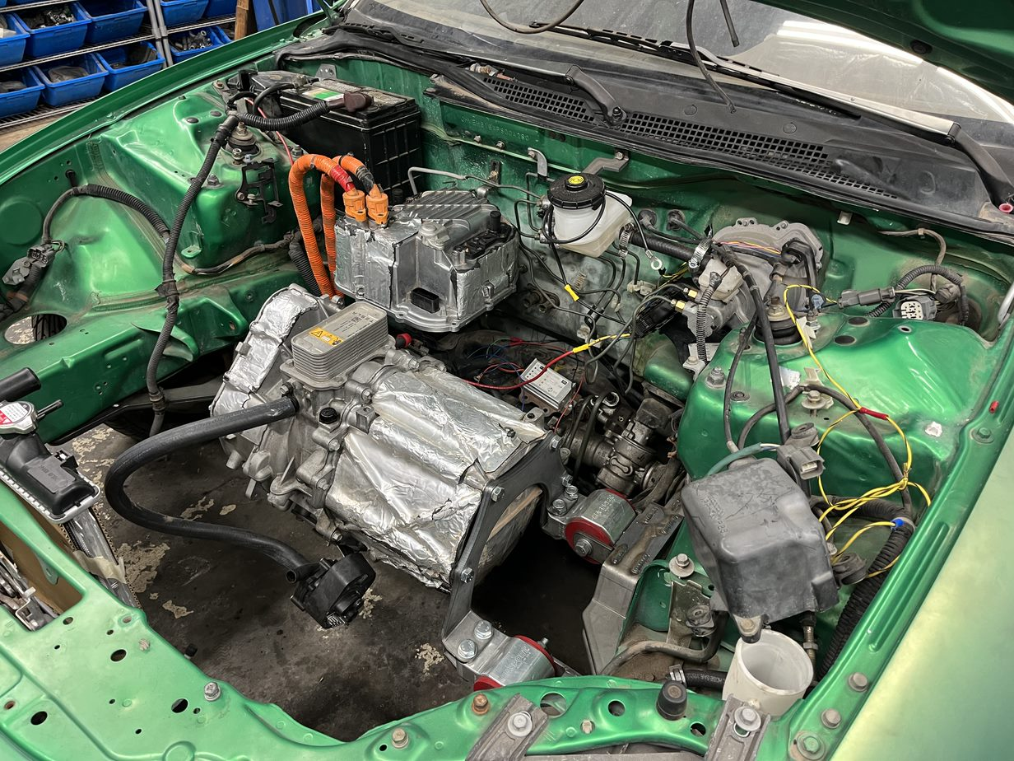
Semester: Spring 2023
Honda Electric Vehicle Conversion Kit
David Brooks , Bryce Greenberg , Joshua Hattaway ,
Paul Howell , Wyatt Watson
Department of Mechanical Engineering, College of Engineering, Informatics, and Applied Sciences, Northern Arizona University, Flagstaff, AZ 86001
Abstract
Methods
Conclusion
The Honda EV Conversion Kit Capstone project aims to manufacture mounts to convert a range of late 1990’s Honda vehicles into electric vehicles (EVs). The kit will be sold by the project’s sponsor company, Hasport Performance Inc., and includes mounting solutions for a Tesla small drive unit (SDU), Chrysler Pacifica hybrid batteries, coolant pump, and oil pump.
The group’s motivation for the project stems from a passion for automotive work and a desire to make EV’s more accessible to the average driver [1]. To design the mount kit, the team took a 1998 Honda Del Sol, provided by Hasport Performance, and used SolidWorks to design brackets. These brackets utilize existing mount points in the vehicle. This approach allows car enthusiasts to perform an electric conversion for a range of late 1990’s Honda vehicles without irreversible modification.
.188" thick sheet steel was used for all components. The sheet steel was cut using a laser cutter and bent using a sheet metal bender. All welds were MIG welds.
Measurements in the engine bay and gas tank were taken using a FARO arm, and the remaining measurements were taken using a combination of tape measures and calipers.
Stress test analyses were performed at all locations where high stress was anticipated, such as the bunny ears holding the motor.
Test customer requirements via bench tests on electronics, then road test the vehicle to verify range
The conversion kit's success will help consumers convert a series of late 1990's Honda vehicles into EVs. The project will help repurpose older vehicles and reduce carbon emissions, both from fuel emissions and the various emissions associated with manufacturing new vehicles. Further implementation of EV conversion kits into other existing vehicles would have a positive effect on the environment and would be more sustainable than either continuing to use gas-powered vehicles or manufacturing new electric vehicles.
References
[1] T. Markovich. "Here's Every Electric Vehicle With a Starting Price Under $40,000." TheDrive.com. https://www.thedrive.com/guides-and-gear/heres-every-electric-vehicle-with-a-starting-price-under-40000 (accessed Oct. 23, 2022).
[2] S. Kaleg, A. Hapid, and M.R. Kurnia, “Electric Vehicle Conversion based on Distance, Speed, and Cost Requirements,” Energy procedia, vol. 68, pp. 446-454, 2015, doi: 10.1016/j.egypro.2015.03.276.
[3] J.D. Kelly, Weber State University. Understanding the Tesla Model S Performance Motor (Feb. 16, 2021). Accessed: Sep. 27, 2022. [Online Video]. Available: https://www.youtube.com/watch?v=MQV3D8F6gvw
[4] “Tesla SDU oil pump modification for reverse operation”. Openinverter.org/forum/viewtopic.php?f=10&t=1728 (accessed Sep. 27, 2022).
[5] “Driving Safety Solutuons: iBooster”. Bosch.com. https://www.bosch-mobility-solutions.com/en/solutions/driving-safety/ibooster/ (accessed Sep. 27, 2022).
Requirements
Results
Battery life sufficient for average commuter (100 miles per charge) [2]
No modification to existing vehicle
Lightweight (less than 3000 lbs.)
Mount solutions for batteries and electric motor
Cooling system for electric motor and batteries
Compatibility to similar vehicle models
Minimum of six batteries in vehicle
Consumer sellable product
Driver's side mount bolts to subframe and two of Hasport's Kflip3 mounts, which hold a plate attached to the Tesla SDU.
Passenger's side mount bolts to subframe and the factory driver's side mount on the SDU.
Consumer friendly modifications were made to the Tesla SDU oiling system to accommodate the use of an external pump [3], [4], as well as maintaining simple mounting and plumbing of the cooling system
Main battery storage holds 5 Chrysler Pacifica hybrid batteries in the original fuel tank location, with an additional battery stored inside the original exhaust pipe tunnel.
Achieved a battery capacity of 16 kWh which is expected to deliver the required 100-mile range
Made new mounts for coolant pumps and fluid reservoirs using existing mount points.
Upgraded the vacuum brake booster to an iBosch electric brake booster [5], already widely used in consumer electric vehicles.
The project vehicle gained about 300 lb and weighs in at about 2800 lb
The kit is entirely bolt in, with no body or frame modifications needed, and has been confirmed to fit directly into a Honda Civic and Acura Integra
A manufacturing cost of only about $300 has been achieved, far below the required $1000
Acknowledgements
Special thank you to Hasport Performance owner, Brian Gillespie, for funding and providing the idea for the project, and to the employees at Hasport for providing guidance while manufacturing and welcoming us into their workspace.

